Slide 1


CSE 115 – PROGRAMMING LANGUAGE
–
□
×
notes.txt
–
□
×
Introduction
Program Flow & Game Board Design
Game Logic
Bug Fixes
Conclusion and Future Improvements
TIC TAC TOE
GROUP 2
TicTacToe.png
–
□
×
Sajir Rashdi Karim
2621130042
Ishteaque Ahnaf
2624254042
Md. Mahfuz Hayder Dilshad
2624833042
Irfan Sadik Ahmed Arnab
2625435042
stats.dat
–
□
×
15
slides ready
01

Slide 2
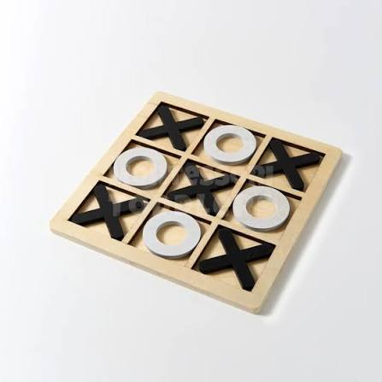
TIC TAC TOE.exe
–
□
×
–
□
×
Introduction.exe
–
□
×
Tictactoe.jpg
–
□
×
Tic-Tac-Toe Game:
A console-based version of the classic
Tic-Tac-Toe game where two players can compete against each other.
–
□
×
.
–
□
×
Group 2
Irfan Sadik Ahmed Arnab
Md. Mahfuz Hayder Dilshad
Ishteaque Ahnaf
Sajir Rashdi Karim
02

Slide 3

TIC TAC TOE.exe
–
□
×
Key Points & Overview
1
Procedural C Programming
Developed using the C programming language.
Uses modular functions and procedural programming concepts.
2
Classic Gameplay
Traditional 3 x 3 Tic-Tac-Toe game for two players.
Players take turns placing X and O.
3
Input Validation
Validates player inputs to prevent invalid moves.
Ensures smooth, reliable and user-friendly gameplay.
4
Winning Conditions
Detects horizontal, vertical and diagonal winning patterns.
Declares a draw when the board is full without a winner.
Group 2
Irfan Sadik Ahmed Arnab
Md. Mahfuz Hayder Dilshad
Ishteaque Ahnaf
Sajir Rashdi Karim
03

Slide 4
TIC TAC TOE.exe
–
□
×
Foundation of Gameplay
1
Declaring a 1D array as a 3x3 board for the game.
Implemented a function to display, clear and refresh the board each round.
Built the main loop-to keep the game running until a win or draw is declared.
Added player switching logic - Alternates turns between player 1 and player 2 which ensures fair and smooth gameplay
2
3
4
Group 2
Irfan Sadik Ahmed Arnab
Md. Mahfuz Hayder Dilshad
Ishteaque Ahnaf
Sajir Rashdi Karim
04

Slide 5

TIC TAC TOE.exe
–
□
×
–
□
×
Section 1 .exe
–
□
×
TicTacToe.jpg
–
□
×
–
□
×
Program Flow &
Game Board Design
.
–
□
×
Group 2
Irfan Sadik Ahmed Arnab
Md. Mahfuz Hayder Dilshad
Ishteaque Ahnaf
Sajir Rashdi Karim
05

Slide 6
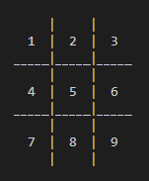
SECTION 01
preview.png
□
–
×
The game follows a “top-down” design:
Input : Get the number from the player.
Process : Update the 1D array and check the rules.
Output : Show the new board with ‘X’ or ‘O’ in the cell.
This design ensures the board to be shown clearly with the spaces and also exchanges the numbered cells with the Character or Symbol which the user already input.
The draw_Board ( ) function was designed to be simple and clear. We used vertical bars ( | ) and horizontal dashes (- - -) to create a recognizable 3x3 grid. This ensures that the screen refreshes every turn.
C
3x3
Programming Language
Grid
Group 2
Irfan Sadik Ahmed Arnab
Md. Mahfuz Hayder Dilshad
Ishteaque Ahnaf
Sajir Rashdi Karim
06

Slide 7

TIC TAC TOE.exe
–
□
×
–
□
×
Section 2.exe
–
□
×
TicTacToe.jpg
–
□
×
–
□
×
Game Logic
.
–
□
×
Group 2
Irfan Sadik Ahmed Arnab
Md. Mahfuz Hayder Dilshad
Ishteaque Ahnaf
Sajir Rashdi Karim
07

Slide 8
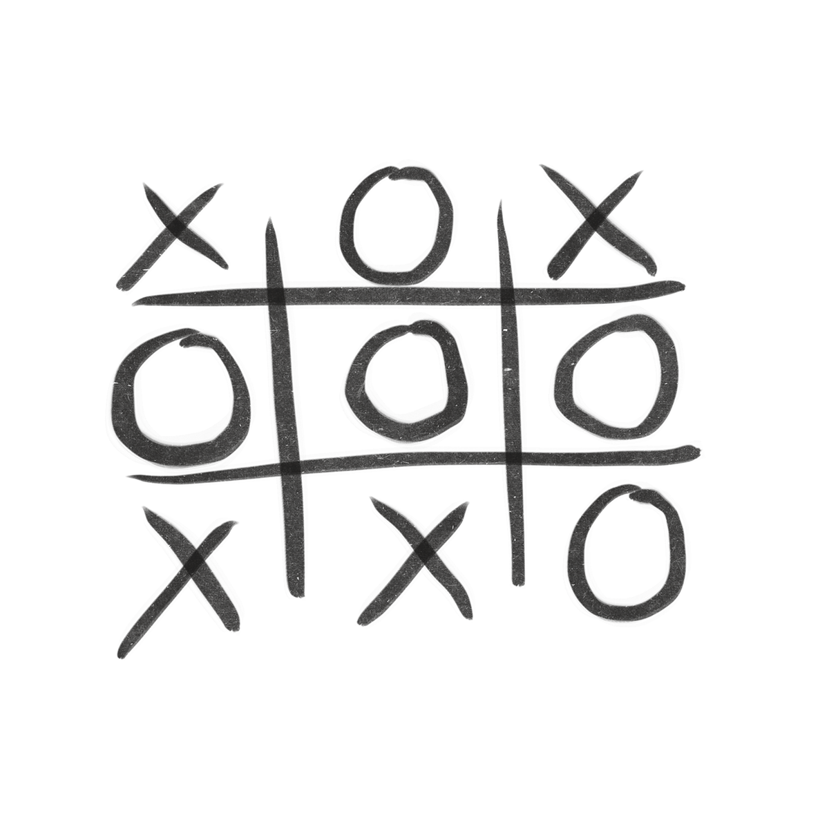
TIC TAC TOE.exe
–
□
×
SECTION 02
The game board is stored using a 1D character array: char board[10];
Players enter a number from 1 to 9, which represents a specific cell on the board.
–
□
×
TicTacToe.png
Then the place_marker() function does two things:
Checks if the slot is between 1 and 9 and not already occupied by X or O.
Places the current player’s marker in the selected slot.
After every move, check_winner() checks all possible winning combinations:
Checks the 3 rows.
Checks the 3 columns.
Checks the 2 diagonals.
If any row, column, or diagonal has the same marker, the function returns 1, meaning a player has won.
Group 2
Irfan Sadik Ahmed Arnab
Md. Mahfuz Hayder Dilshad
Ishteaque Ahnaf
Sajir Rashdi Karim
08

Slide 9
TIC TAC TOE.exe
–
□
×
Main Game Loop
The while loop keeps the game running until there is a win or draw.
Then the loop does these things in order:
SECTION 02
–
□
×
TicTacToe.png
Draws the board and asks the current player to enter a slot number.
Validates the input to make sure the player enters a number.
Places the marker if the selected slot is valid.
Counts the turn after a successful move.
Checks for a winner or a draw after every move.
If the game is still ongoing, switches the turn between Player 1 (X) and Player 2 (O).
Group 2
Irfan Sadik Ahmed Arnab
Md. Mahfuz Hayder Dilshad
Ishteaque Ahnaf
Sajir Rashdi Karim
08

Slide 10

TIC TAC TOE.exe
–
□
×
–
□
×
Section 3.exe
–
□
×
TicTacToe.exe
–
□
×
–
□
×
Bug Fixes
.
–
□
×
Group 2
Irfan Sadik Ahmed Arnab
Md. Mahfuz Hayder Dilshad
Ishteaque Ahnaf
Sajir Rashdi Karim
09

Slide 11
SECTION 03
Bug Fix 1
Before / After
before.exe
–
□
×
after.exe
–
□
×
Before
After
To solve this problem, getchar() was used along with scanf() to clear unwanted input from the input buffer:
During testing, when a letter was accidentally entered instead of a number, the program would enter an infinite loop and eventually crash because the invalid input remained in the input buffer.
if (scanf("%d", &choice) != 1) {
while (getchar() != '\n’);
continue;
}
Outcome: This improvement prevented infinite loops and resulted in smoother gameplay with stable and reliable user input handling.
Group 2
Irfan Sadik Ahmed Arnab
Md. Mahfuz Hayder Dilshad
Ishteaque Ahnaf
Sajir Rashdi Karim
10

Slide 12
SECTION 03
Bug Fix 2
Before / After
before.exe
–
□
×
after.exe
–
□
×
Before
After
To solve this problem, place_marker() was used to
clear unwanted input from the input buffer:
Sometimes, Players could overwrite existing marks (X or O) on the board
int place_marker(int slot) {
if (slot < 1 || slot > 9 || board[slot] == PLAYER_X || board[slot] == PLAYER_O) {
return 0; }
Outcome: This makes sure only a vacant slot is used by a player and it doesn't overwrite past input of other player.
Group 2
Irfan Sadik Ahmed Arnab
Md. Mahfuz Hayder Dilshad
Ishteaque Ahnaf
Sajir Rashdi Karim
10

Slide 13

TIC TAC TOE.exe
–
□
×
–
□
×
Section 4.exe
–
□
×
TicTacToe.jpg
–
□
×
–
□
×
Conclusion and Future Improvements
.
–
□
×
Group 2
Irfan Sadik Ahmed Arnab
Md. Mahfuz Hayder Dilshad
Ishteaque Ahnaf
Sajir Rashdi Karim
11

Slide 14
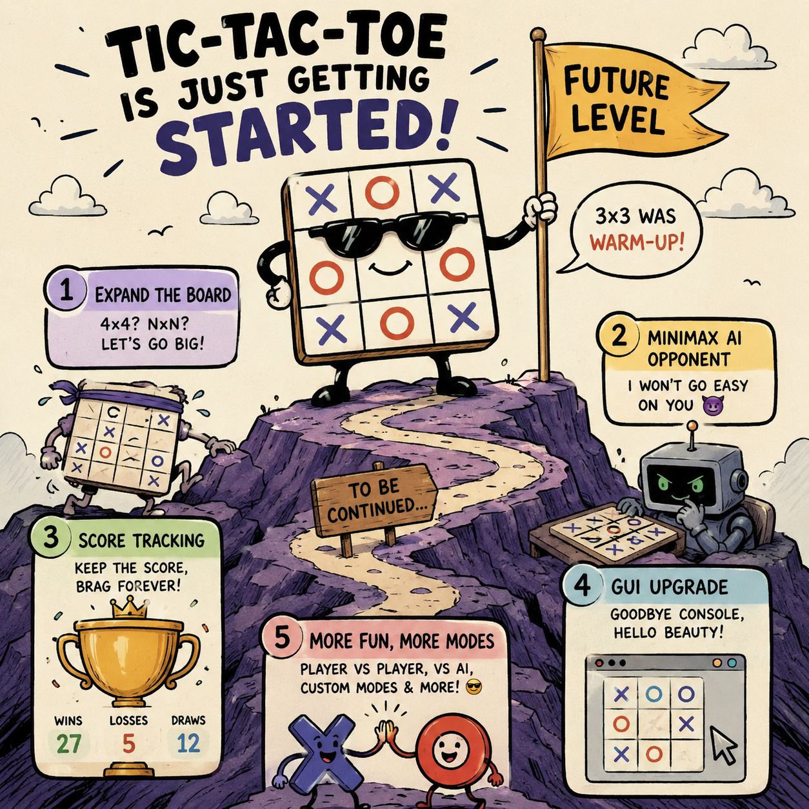
TIC TAC TOE.exe
–
□
×
SECTION 04
So, we have developed a robust, bug-free Tic-Tac-Toe console game which has been designed for fast, competitive local play. This project allowed as to demonstrate all of the core C programming concepts which were learnt over this semester.
Future Scope:
Expand to a 4×4 or NxN board
Implement Computer opponent
Add leaderboard system
Upgrade to GUI-based version
–
□
×
futureplan.jpg
Group 2
Irfan Sadik Ahmed Arnab
Md. Mahfuz Hayder Dilshad
Ishteaque Ahnaf
Sajir Rashdi Karim
12

Slide 15

Thank You
Group 2
Irfan Sadik Ahmed Arnab
Md. Mahfuz Hayder Dilshad
Ishteaque Ahnaf
Sajir Rashdi Karim
12

